Slide 1
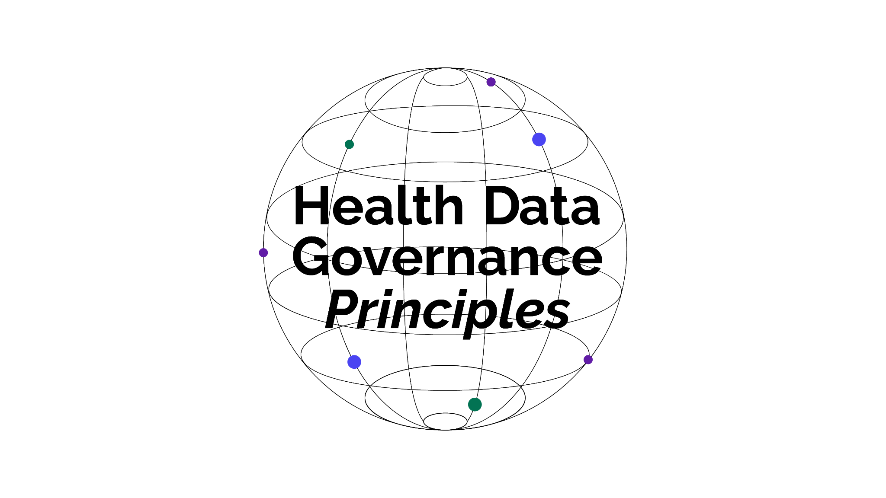
HEALTH DATA
GOVERNANCE
PRINCIPLES
Universalising the benefits of health digitalisation
Protect people | Promote health value | Prioritise equity

Slide 2
INTRODUCTION &
OVERVIEW
The Health Data Governance Principles:
Bring a human rights and equity lens to the use of data within and across health systems.
Are oriented towards supporting sustainable and resilient public health systems that can deliver Universal Health Coverage (UHC).
Aim to strengthen national and regional health data governance approaches, maximising the public value of health data whilst protecting individual rights.
Align policymakers and other stakeholders around a shared vision of equitable health data governance, where all people and communities can share, use and benefit from health data.
Recognise and build on existing norms, principles, treaties, conventions and guidelines, while further strengthening the health data governance ecosystem.
Are a critical step towards a global framework for health data governance.

Slide 3
DEVELOPMENT OF
THE PRINCIPLES
Driven and developed by civil society through an inclusive and consultative, bottom-up process.
The process was designed to gather perspectives and expertise, and ensure meaningful engagement, of diverse stakeholders from across geographies and sectors.
Over 200 contributors from over 130 organisations.
Eight global and regional workshops covering Sub-Saharan Africa; the Middle East and North Africa; South, East, and Central Asia; Latin America and the Caribbean; and Europe, North America, and the Pacific.
One-month public consultation on a draft set of Principles.
Transform Health stewarded this process, under the leadership of its Policy Circle.

Slide 4
OBJECTIVES &
STRUCTURE
The Principles are clustered around three interconnected objectives:
Protect people – as individuals, as groups, and as communities
Prioritise equity – by ensuring equitable distribution of benefits that arise from the use of data in health systems
Promote health value – through data sharing and innovative uses of data
The Principles are:
Designed to complement and reinforce one another.
Not weighted or listed in any order of priority.
Supported by core elements that describe how it can be put into practice.

Slide 5
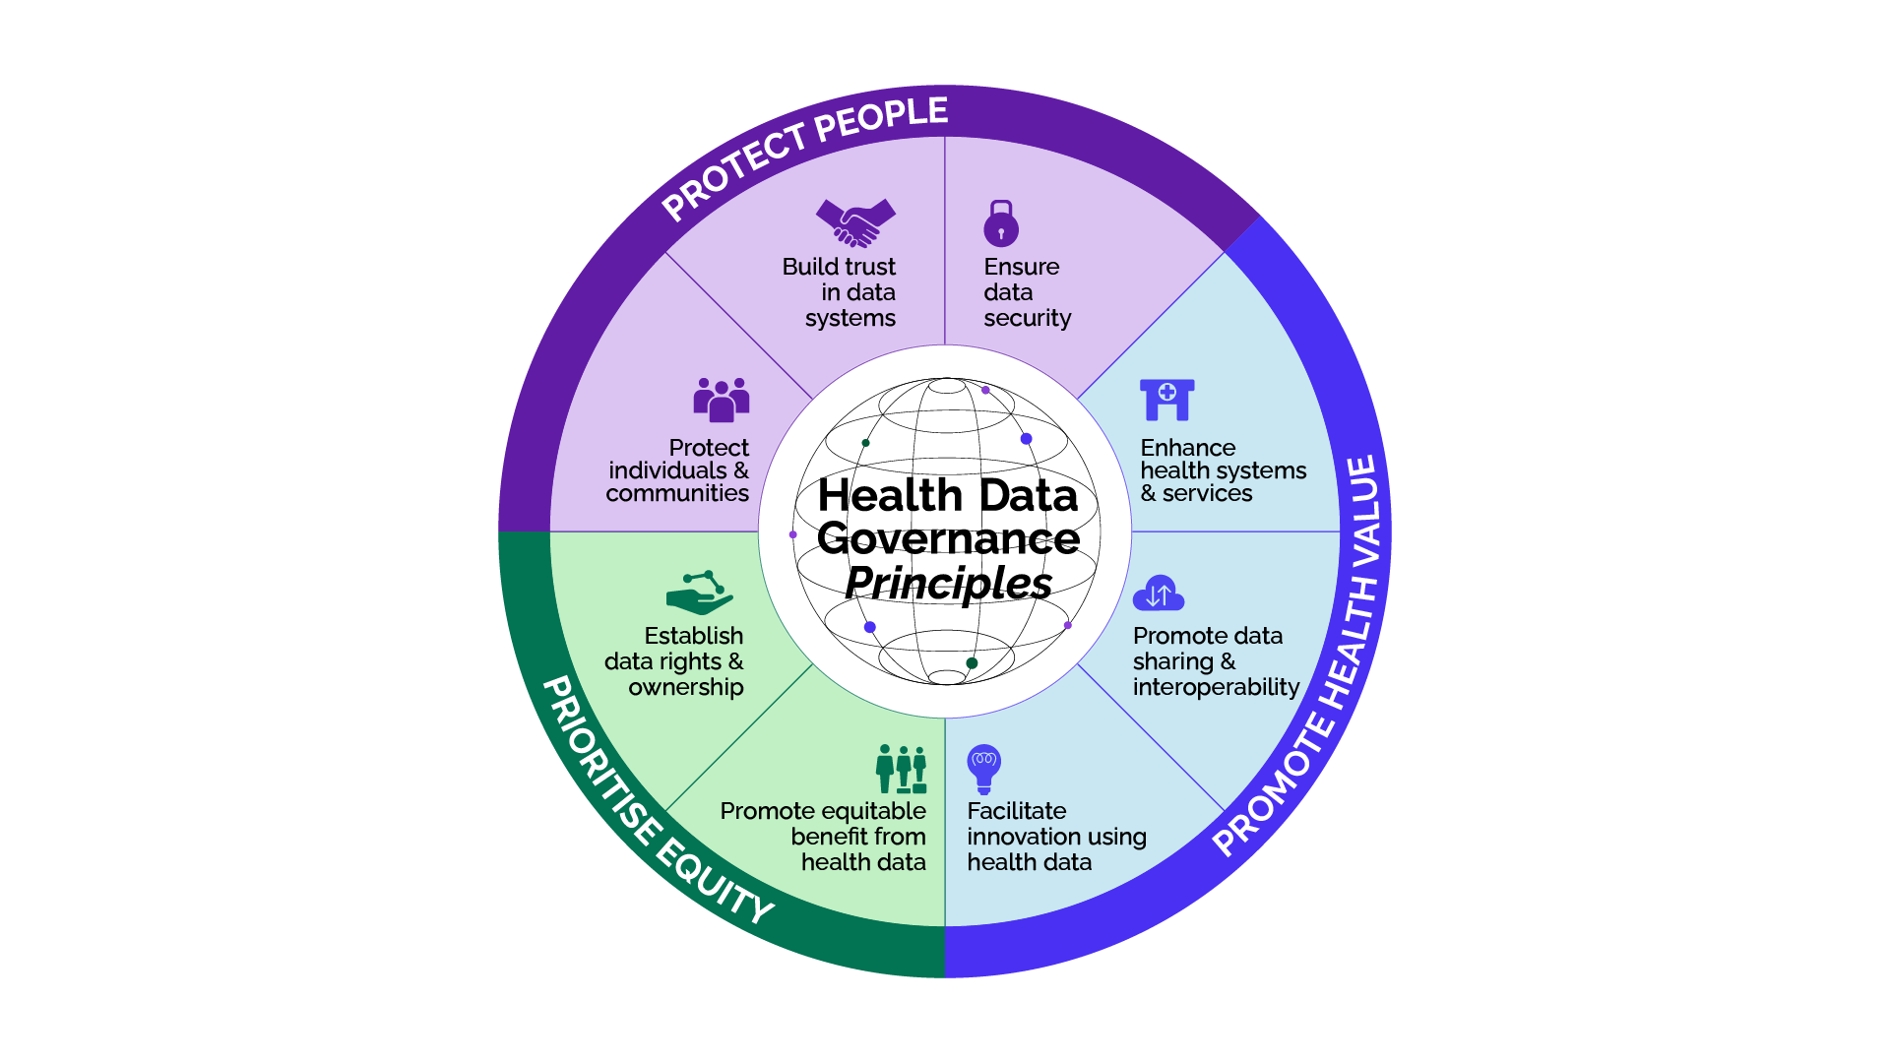
THE PRINCIPLES

Slide 6
PROTECT PEOPLE

Slide 7
PROTECT PEOPLE
Health data governance must protect individuals, groups and communities against harm and violations at every stage of the data lifecycle. It should balance protection and rights with the societal value of data use for health.
PROTECT INDIVIDUALS
AND COMMUNITIES
Core Elements
Address individual and collective risk
Collect data with a defined purposes
Collect personal or sensitive data only when necessary and with informed consent
Use secure data collection and storage mechanisms
Use de-identification and anonymization
Define inappropriate uses of health data
Institute safeguards against discrimination, stigma, harassment and bias
Provide guidance specific to marginalised groups and populations

Slide 8
PROTECT PEOPLE
Health data governance should reinforce trust in data systems and practises. Developing health data governance systems in a participatory and transparent manner, and ensuring regulations and guidelines are accessible, understood, and followed in practice, can help build trust.
BUILD TRUST IN DATA SYSTEMS
Core Elements
Align with best practises for data protection and privacy
Ensure consent is informed and understood in all its complexities
Obtain collective consent where appropriate
Define concrete exceptions to informed consent
Ensure data quality, availability, and accessibility
Reinforce health data governance with evidence
Establish transparent and accessible processes and systems
Institute feedback and accountability mechanisms

Slide 9
PROTECT PEOPLE
Data security is an essential component of health data governance, for the protection of individuals and communities. Processes for collecting, processing, storing, using, sharing and disposing data should all employ robust security mechanisms.
ENSURE DATA
SECURITY
Core Elements
Require strong technical security measures for data processing
Mitigate risks related to security threats
Ensure transparency around data breaches
Consider federated data systems

Slide 10
PROMOTE HEALTH VALUE

Slide 11
PROMOTE HEALTH VALUE
Health data governance should enhance health system efficiency and resilience, improve health access, and advance health equity towards UHC. A whole health system approach must be applied, ensuring health data governance supports the systemic transformation of health systems.
ENHANCE HEALTH
SYSTEMS AND SERVICES
Core Elements
Evaluate the benefits of health data
Use data to enhance health services for individuals and communities
Encourage a culture of data-led insights and action
Address health system efficiency, effectiveness, and resilience
Strengthen community ownership of health data
Enable and empower frontline health workers

Slide 12
PROMOTE HEALTH VALUE
Data collection and sharing is a prerequisite for creating value from health data but must be done in ways that support equity and human rights. Data sharing allows for deeper and more significant insights related to health needs and challenges.
PROMOTE DATA
SHARING AND
INTEROPERABILITY
Core Elements
Establish data sharing rules and guidelines
Validate informed consent before sharing data
Promote interoperability of data systems
Define common data structures across health systems
Define multiple levels of data access
Use common definitions and global standards
Support multi-sector partnerships

Slide 13
PROMOTE HEALTH VALUE
Health data governance should enhance health system efficiency and resilience, improve health access, and advance health equity towards UHC. A whole health system approach must be applied, ensuring health data governance supports the systemic transformation of health systems.
FACILITATE INNOVATION USING HEALTH DATA
Core Elements
Apply health data governance to emerging technologies
Address the use of non-health data in health contexts
Build public health data infrastructure
Employ policy innovation

Slide 14
PRIORITISE EQUITY

Slide 15
PRIORITISE EQUITY
Health data governance must ensure equitable representation in data of all individuals, groups and communities; meaningful participation of all groups in decision-making; and equitable access to data-generated health value.
PROMOTE EQUITABLE BENEFITS FROM HEALTH DATA
Core Elements
Represent all groups and populations equitably in data
Consider the unique needs of marginalised groups and populations
Mitigate data bias
Use accessible language and plug knowledge gaps
Implement inclusive data feedback mechanisms
Promote equitable impact and benefit

Slide 16
PRIORITISE EQUITY
Health data governance should be rooted in strong and clear data-related rights. Data-related norms, principles, policies, and laws should be drawn from such overarching rights. This includes consideration of all human rights.
ESTABLISH DATA RIGHTS & OWNERSHIP
Core Elements
Apply a human rights lens to health data governance
Define clear governance roles and responsibilities
Codify data rights and ownership
Extend data rights and ownership to products and services
Develop health data trusts and health data cooperatives
Employ participatory data governance mechanisms
Connect to broader accountability mechanisms

Slide 17
Adopting the Principles and a global framework

Slide 18
DRIVING ACTION ON THIS AGENDA
Governments, regional bodies and organisations are urged to take action to strengthen the governance of health data by:
Endorsing the Health Data Governance Principles.
Supporting the development, and subsequent adoption, of a global health data governance framework, underpinned by the Principles.
Prioritising health data governance as part of global, regional and national agendas.
All stakeholders, including civil society and communities, should champion this agenda, advocating for action and holding governments and other stakeholders accountable.
Communities, particularly the most marginalised, must be meaningfully engaged in discussions and decision making.

Slide 19
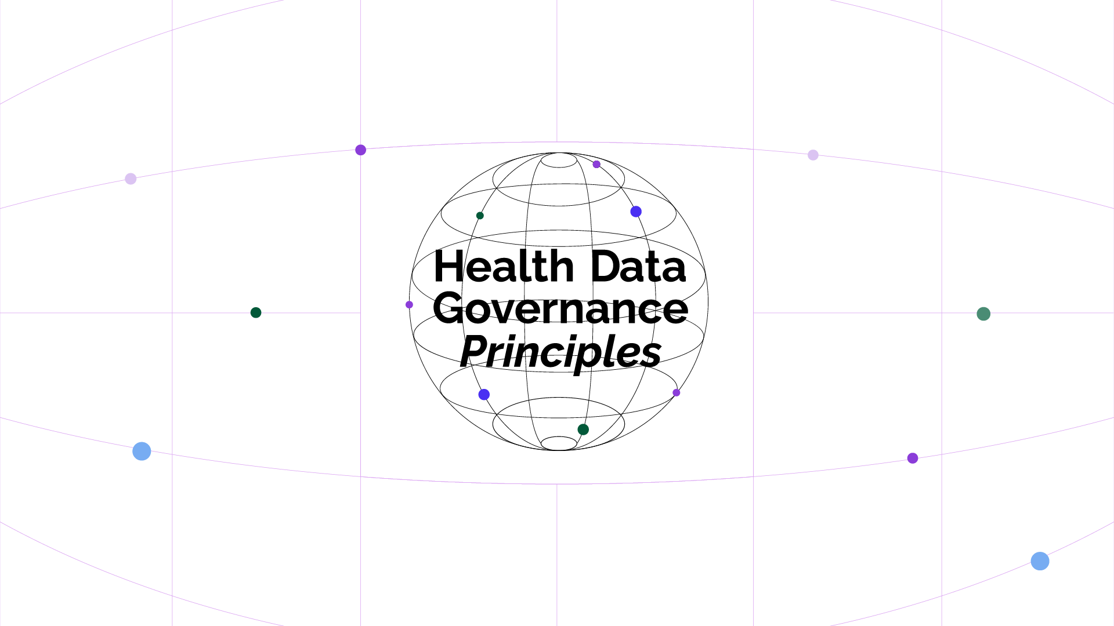
healthdataprinciples.org

